Slide 1

PMAS-Arid Agriculture University Rawalpindi University Institute of Information Technology
Image based Malware classification
Group Members:
1. Shahid Akhter
2. Hamza Khan
3. Shuja Sultan
17-ARID-2038
17-ARID-1996
17-ARID-2042
Supervisor:
Mr.Zeeshan Javed

Slide 2
Agenda
Introduction
Existing System
Problem Statement
Proposed Solution
Project Scope
Project Objectives
Diagrams
Use case
Sequence
Activity
Data Flow
Class Diagram
Deployment
Tools and Technologies
Screen Shots
Conclusion & Future Work
Notes:
Number of Diagrams will be according to Supervisor

Slide 3
Introduction
The most challenging part of internet security is discovering malware variants. The exponential increase in malware attacks has become one of the major threats to Internet security.
A recent threat report from Symantec indicated that their 123 million sensors record thousands of malicious threat events per seconds on daily basis.
The presence of malware in the internet of things (IoT) and mobile devices increased. According to the latest threat report from Kaspersky Lab in 2019, remove the number of users that encountered Android malware more than tripled to 1.7 mil- lion globally.
Connectivity between an IoT device and a personal computer is established through a cloud service..
Malware is separated into various classes by their functionalities i.e., Viruses, Worms, Trojans, and Backdoors. These classes further divide into families based of the type of variants. Malware writers deploy many obfuscation methods such as dead-code insertion, subroutine reordering, and code transposition, to create variants of an existing malware family in order to evade detection
Notes:
Only Bullets no need to add paragraph on all slides

Slide 4
Existing System
In law enforcement agencies throughout the world, there are growing digital forensic backlogs of un imaged, unprocessed, and unanalyzed digital devices stored in evidence lockers. The sheer volume of cases requiring digital forensic processing extends far beyond digitally executed crimes such as phishing, online sharing of illicit content, online credit card fraud, etc. In this model deep learning is used for classification of malware, the final model has 98:8% accuracy based on the validation data, and it requires raw binary of the file for analysis.
In this system different pretained models like ResNet50, VGG16 etc. are used for the classification of malwares by using images. This model use Static analysis and visualization analysis for the detection and classification of malwares. Using image processing technique, Nataraj et al. (2011) visualized malware binaries into grayscale. Through a machine learning approach such as GIST they extracted features from malware grayscale. Accuracy reached 97.18% on a dataset containing 9458 malware samples related to 25 different malware families. it takes 1.18 s on average to identify new malware samples but if the number of images increase its average time will increase.
This Deep learning model use both supervised and unsupervised learning model for the training purpose while in these learning models machine learning is used and deep learning is also used with grayscale images and all these come forward from binary files, in the end the classification is performed. But it achieved about 98.6% accuracy for SVM based malware detection but it consumes much time.
Hybrid deep learning model (IMCFN) which combines the visualization and fine-tuned CNN architecture for malware detection and classification that are computationally cost-effective IMCFN algorithm is mainly divided into two parts: malware image generation and CNN fine-tuning via backpropagation technique. During the fine-tuning, they utilized data augmentation technique to improve the performance. The experimental investigation analysis was carried out by implementing the various programs in Python Programming Language. The experiment was run in NIVIDIA Ti-1080 12GB GPU for training and Intel Core i7-4790 processor with 8 GB main memory for classification.
Notes:
Add Figures where ever necessary to explain the system

Slide 5
Problem Statement
In All above shared models of Malware classification Accuracy is compromised and they clams high accuracy apart from that they take much time but gives less accuracy, several models acquire high cost and their datasets are fabricated.
IMCFN the experiment was run in NIVIDIA Ti-1080 12GB GPU which is costly product. Several models are only for technical persons, non-technical person may have no knowledge that how to use trained model or how to use model for taking better results. As we know numbers of devices and users on internet increasing day by day and threat to data is very high because cyber security will be compromised.

Slide 6
Proposed Solution
We mainly use Image processing in our model with malmig dataset, in order to get an enhanced image or to extract binary data information from it and we will use combined dynamic and static visualization with malmig dataset to add up more accuracy. We can also create our own dataset for model training purpose if needed. We will use combined approach and then compare the results in such a way we can get comparatively more accuracy in less time.

Slide 7
Project Scope
Scope
Data Gathering:
In Image based Malware classification we use Malimg dataset.The Malimg dataset contains 9339 malware images, belonging to 25 families/classes. Thus, our goal is to perform a multi-class classification of malware. This dataset is used for training of model. Dataset For the experiments, We will use the malware data from the Microsoft Malware Classification Challenge (BIG, 2015) on Kaggle (Ronen et al., 2018), the labeled training dataset of 10; 868 samples.
Data Processing:
We employed the following CNN models, each having various capabilities: VGG16 network architecture (Simonyan and Zisserman, 2014). This well-known CNN has a standard neural network architecture of connected layers and contains 16 layers needing to be trained, 5 convolutional layer blocks and 3 fully-connected layers.
3. Testing and training using machine learning:
Transfer learning consists of transferring the parameters of a neural network trained with a single dataset and task to another problem with a different dataset and task (Özbulak et al., 2016; Long et al., 2018). Many deep neural networks trained on natural images share an interesting phenomenon in common When the target dataset is significantly smaller than the base dataset, transfer learning can be a powerful tool to enable the training of a large target network without overfitting. Next, We employed the convolutional layers of VGG16 and ResNet-50 to obtain malware image bottleneck features, which then served as input in training SVM classifiers.
Dynamic analysis:
Dynamic analysis works by executing the malicious code in a virtual environment, simulator, and sandbox. Monitoring tools like process monitor or capture BAT install before running the malicious code. Dynamic analysis can be effective with runtime information, such as running process or by using control flow graph that could be less prone to obfuscated malware’. In the dynamic visual analysis of malware, various methods such as tree map, thread graph, and malware behavior image have been proposed.

Slide 8
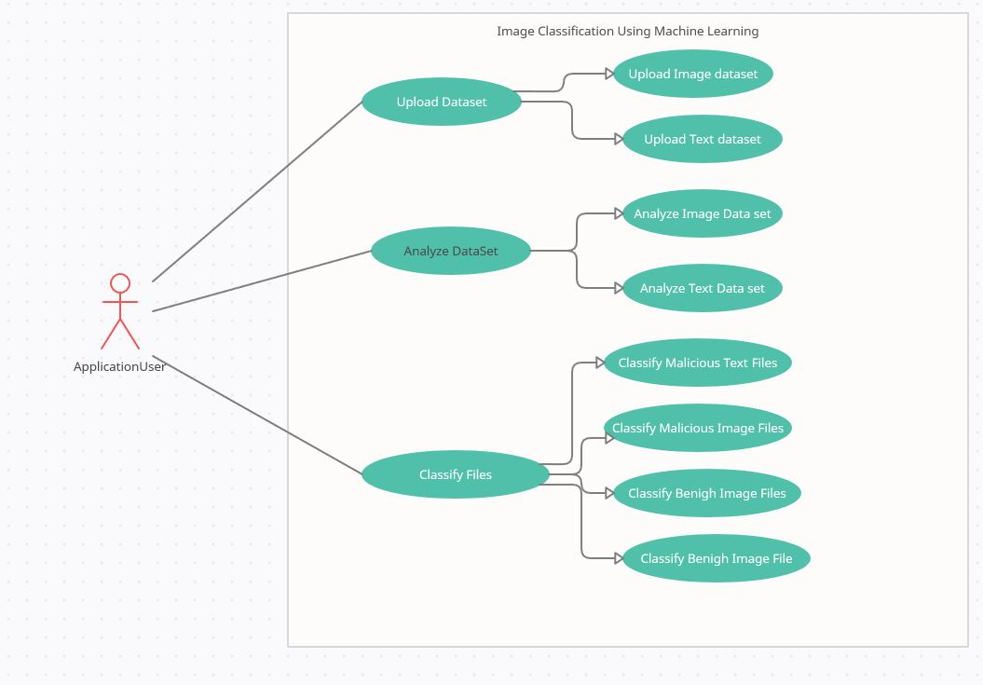
Diagrams…(Use Cases)
Notes:
All diagrams will be in PDF and their hyperlinks should be here to make it more visible

Slide 9
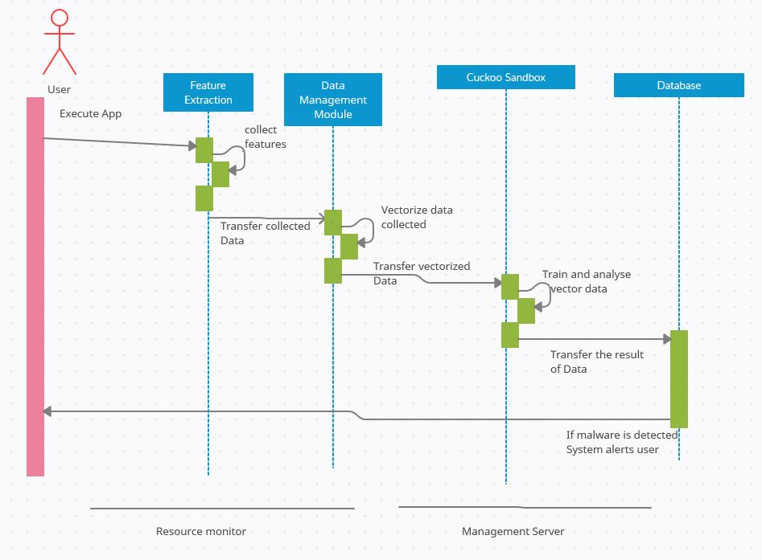
Diagrams…(Sequence)

Slide 10
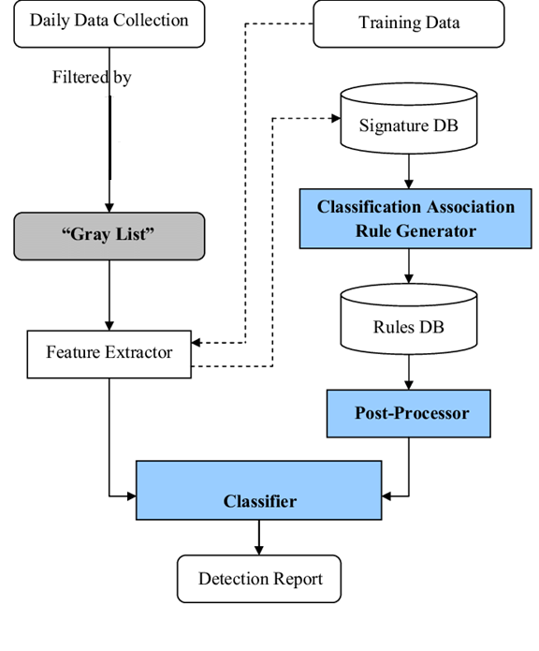
Diagrams…(DataFlow)

Slide 11
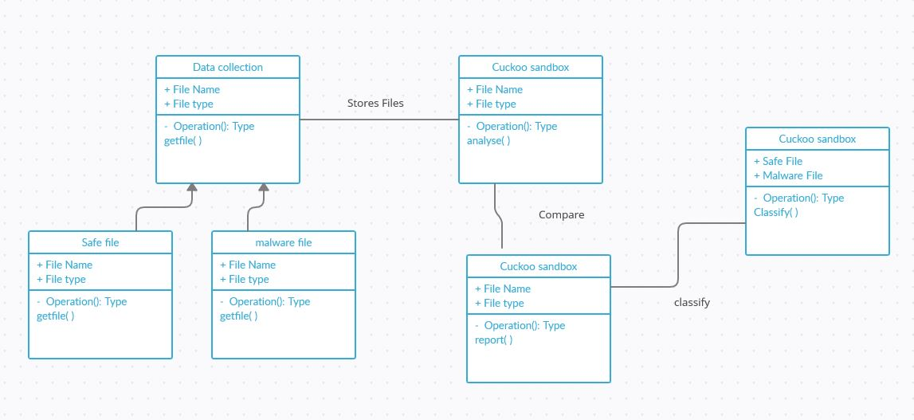
Diagrams…(Class)

Slide 12
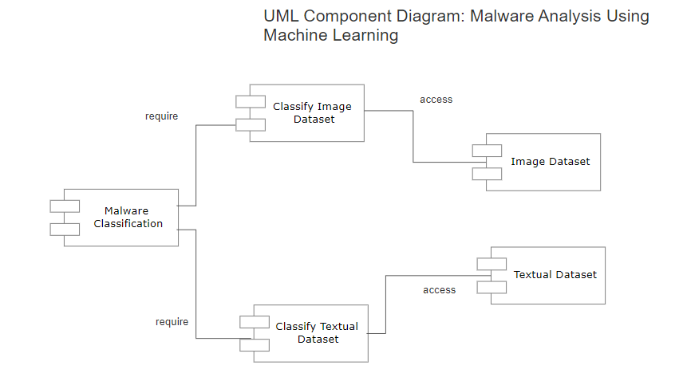
Component Diagram

Slide 13
Tools and Technologies
Tools:
Pycharm
Vmware
Adobe illustrator
Mysql
Technologies:
Python
Artificial Intelligence
Notes:
Tools, Language, System Specs etc.

Slide 14
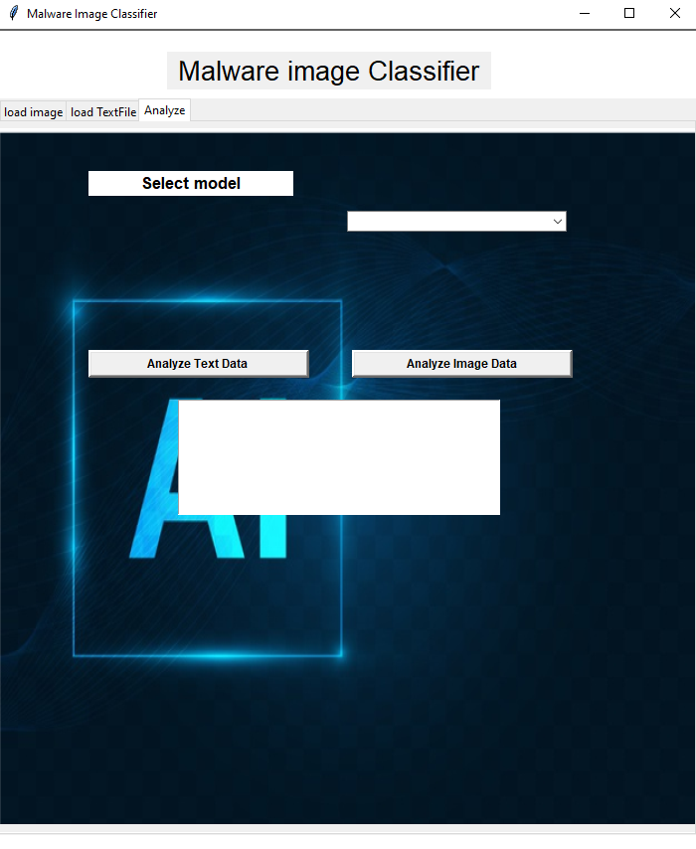
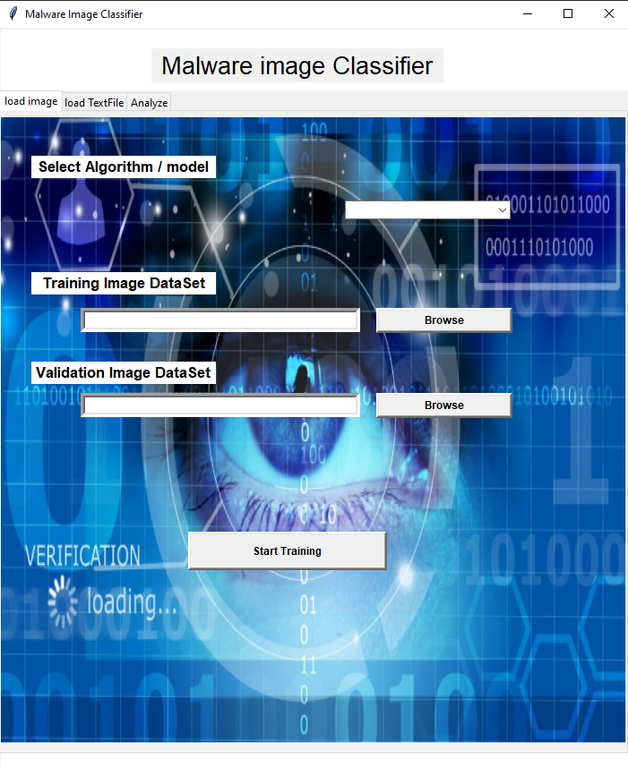
Screen Shots
Notes:
At least one interface and should be in running form.

Slide 15
Conclusion & Future Work
There is a constant race between cyber-attackers and antimalware software. Therefore, it is necessary to maintain the persistent pressure on cyber-attackers.
Malware is a common attack vector to the internet. In this paper, we propose a malware classification technique called image based malware classification, which combines malware static and dynamic visualization and ne-tuned CNN architecture already trained on malimg & ImageNet dataset.
Data augmentation method is adopted to improve the performance. The experimental results show the excellent classification capability of image based malware classification. The classification accuracy is 98.82% for Malimg dataset, which is higher than other discussed methods.
Compared with well-known classification methods based on colored images analysis, our model achieves lower computational costs and better results in terms of accuracy. Experimental outcomes proved that image based malware classification algorithm is also remained effective with 97.5% accuracy rate. The transformation of malicious code into gray scale images need to be explored in future research.

Slide 16


